Slide 1
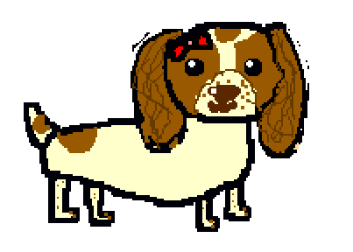
Maisy finds the culprit
D
Logic in computing is using careful reasoning to find a solution.
Written and illustrated by
Beth Mead
aged nine
(Revised in Year 6)
Computer coding concept: Logic

Slide 2
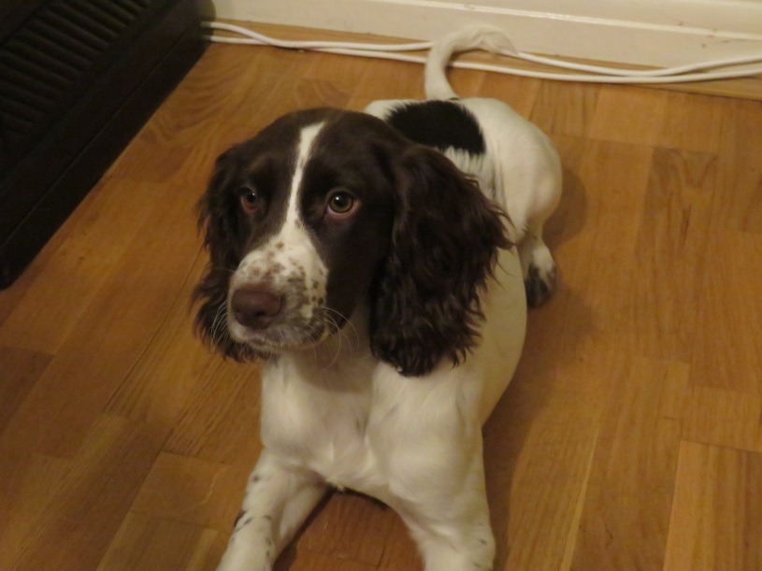
Maisy is a real dog, who lives with Beth in
south London, and she actually likes cheese!

Slide 3
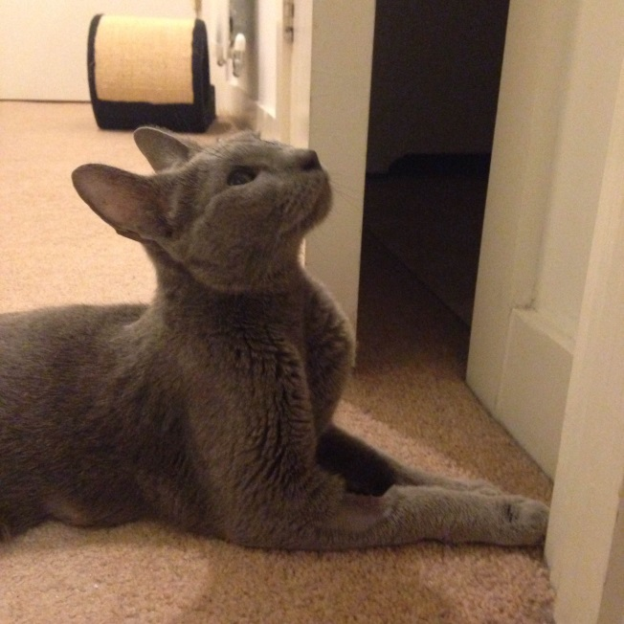
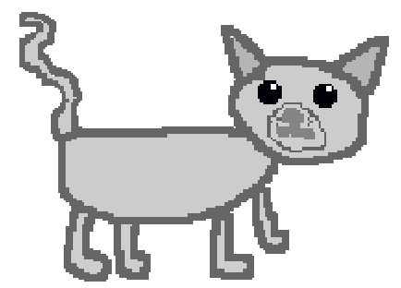
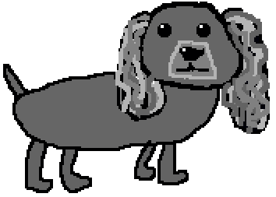
This is Malika, also real. She is a Russian Blue cat. But she is neither Russian, nor blue…..
Storm is a fictional (made up) friend to Maisy.

Slide 4
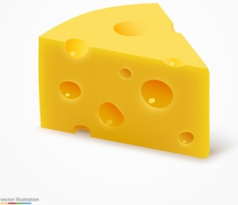


Maisy arrived home from her walk in the park. She hoped to find her dinner waiting for her in her bowl, as usual. The nice old lady, called Jean, who looked after her, always put her dinner in her dog bowl. Maisy really loves cheese.
Yum!

Slide 5

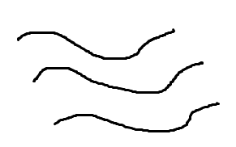
But when she looked for her dinner, her bowl was empty! Where had the food gone? Maisy was shocked! She knew that nice Jean would never forget to feed her. This was a real mystery!
But are there any clues here?
Footprints...
Short black hairs…
Empty bowl!

Slide 6
Maisy then remembered that the last time Jean had not been able to feed her was when poor Jean had been ill. Perhaps she was ill again. Kind-hearted Maisy set off to check that Jean was all right.

Slide 7
On the way to find Jean, Maisy bumped into Storm. Storm asked her why she looked so worried. Maisy told him about the mystery of her missing dinner.
“I think someone must have eaten it”, said Storm.
“We must find out who took it!” said Maisy.

Slide 8
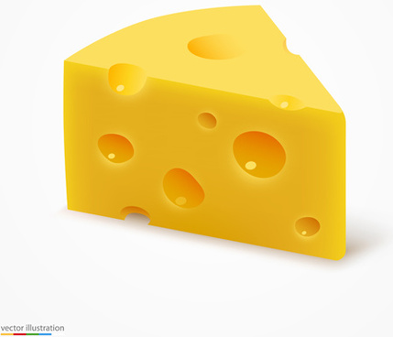
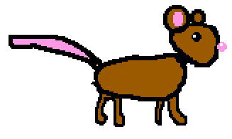
Maisy went to see Jean, who said that she had put Maisy’s favourite Cheddar cheese into the bowl. Maisy’s first thought was that a mouse must have taken it. Mice like cheese!
Wow
Wow!
Look at that!
Let me get at it!

Slide 9
There were some muddy paw prints around the bowl, and some hair. The paw prints were much too big to be a mouse, so Maisy looked at the three hairs by the bowl. They were short, slightly curly, and black.

Slide 10
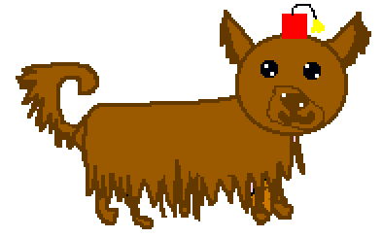
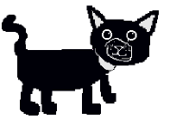
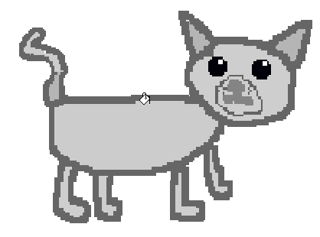
It might have been Malika, or one of her other friends, Dusty or Magnus, or even Storm. Or a mouse? But, which one?
Dusty is a brown cat, with long straight hair. Storm has long curly hair. Squeaky the mouse has short brown hair. Malika has short grey hair. Magnus has short, black hair.
Storm
Dusty
Squeaky the mouse
Magnus
Malika

Slide 11
The evidence
Maisy and Storm sat down to look at all of the clues. They thought about each possible culprit. They then made some lists of the clues. They matched the clues up to each possible secret dinner eater! Was it…….?
OR
Malika
Dusty
OR
Storm
Magnus
Squeaky the mouse

Slide 12
Was it Squeaky?
Clues:
Empty bowl
AND
Loves cheese
AND
Leaves paw prints
But… paw prints are
NOT the right size
Hairs are
NOT the right colour
AND, OR, NOT, or AND NOT are called Boolean operators, after George Boole. They are always written in CAPITAL letters.

Slide 13
Was it Malika?
Clues:
Loves cheese
AND
Leaves paw prints
AND
Paw prints are the right size
But…
Hair is
NOT the right colour

Slide 14
Was it Dusty?
Clues:
Loves cheese
AND
Leaves paw prints
AND paw prints are the right size
But…Hair is
NOT straight

Slide 15
Was it Storm?
Clues:
Does NOT love cheese.
AND
Paw prints are too small
AND
Hairs are too straight
So who could it be?

Slide 16
Was it Magnus?
Clues:
Empty dog bowl
AND
Paw prints are dog size
AND
Hairs are short and slightly curly
AND
Hairs are black
Now read on…….
?

Slide 17
Storm went back home for his dinner. Maisy said, “I think I know who did it!”
Using Boolean logic, can you work out who ate Maisy’s dinner, and how Maisy knew?
Hint: Look at the ANDs and the NOTs in the lists of clues. Who has the most ANDs without any NOTs?
Who do you think ate Maisy’s dinner?

Slide 18

Maisy’s list of culprits:
Malika
Dusty
Storm
Squeaky
Magnus
Cheese!
Yum!
But it was Maisy’s…

Slide 19
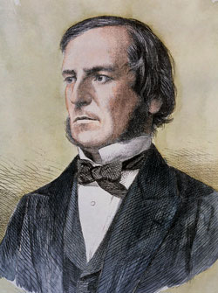
Later, Magnus said that he was very sorry for eating Maisy’s dinner! (Did you work this out?) So, Magnus kindly let Maisy eat his own ham dinner, because he had eaten her Cheddar cheese dinner.
The moral of this story is that the truth always comes out, no matter what.
Especially if there are any clues left behind, for logical thinkers to work out.
And you use a bit of logic.
Boolean logic, of course!
Thank you, George!
Sorry
Sorry, Maisy!
You should always tell the truth!
Thanks! But it was not really me. It was my logic.

Slide 20
Did you know?
Whenever you use Google to search the Internet, Google automatically adds an invisible Boolean AND between the words in your search? Tapping the space bar between the words adds a Boolean AND!
Every time!
(http://libguides.mit.edu/c.php?g=175963&p=1158594)
George Boole was an English mathematician, educator, philosopher, and logician. He wrote about equations and logic. He is best known as the author of “The Laws of Thought” which contains his Boolean algebra, a part of maths.

